Slide 1

Phishing website & Detection
V4

Slide 2

Content Overview :
Introduction
Objective
Proposed Approach
Explanations
Live Demo Of Phishing Sites Prediction
Deployment
End

Slide 3
Introduction :
Phishing is the most commonly used social engineering and cyber attack.
Through such attacks, the phisher targets naïve online users by tricking them into revealing confidential information, with the purpose of using it fraudulently.
In order to avoid getting phished:-
Of the above three, the machine learning based method is proven to be most effective than the other methods.
Even then, online users are still being trapped into revealing sensitive information in phishing websites.
Users should have awareness of phishing websites.
Have a blacklist of phishing websites which requires the knowledge of website being detected as phishing.
Detect them in their early appearance, using machine learning and deep neural network algorithms.

Slide 4
Objective
A phishing website is a common social engineering method that mimics trustful uniform resource locators (URLs) and webpages. The objective of this project is to train machine learning models and deep neural nets on the dataset created to predict phishing websites. Both phishing and benign URLs of websites are gathered to form a dataset and from them required URL and website content-based features are extracted. The performance level of each model is measures and compared.

Slide 5
Approach:
Below mentioned are the steps involved in the completion of this project:
Collect dataset containing phishing and legitimate websites from the open source platforms.
Write a code to extract the required features from the URL database. • Analyze and preprocess the dataset by using EDA techniques.
Divide the dataset into training and testing sets.
Run selected machine learning and deep neural network algorithms like SVM, Random Forest, Autoencoder on the dataset.
Write a code for displaying the evaluation result considering accuracy metrics.
Compare the obtained results for trained models and specify which is better.

Slide 6
Data Collection:
Legitimate URLs are collected from the dataset provided by University of New Brunswick, https://www.unb.ca/cic/datasets/url-2016.html.
From the collection, 5000 URLs are randomly picked.
Phishing URLs are collected from opensource service called OpenPhish. This service provide a set of phishing URLs in multiple formats like csv, json etc. that gets updated hourly.
Form the obtained collection, 5000 URLs are randomly picked.

Slide 7
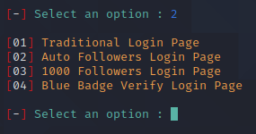
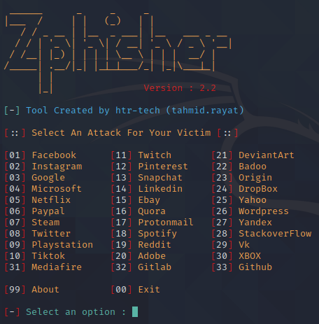
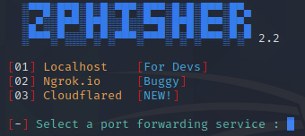
Working Process :
-> In the following pictures we observe the attacker user interface and select options.
->Then he gives type of attack he needs 1) Localhost(127.0.0.10)
2)ngrok.oi
3)Cloudflare
-> Generated url will be sent to victims phone through a message or popup.
->While victim receives the link he tries to open and login with his credentials ...but he gets a display of error password or try again.
-> Now the login credentials or displayed in attackers user interface.
-> This is how the phishing attacks occurs.

Slide 8
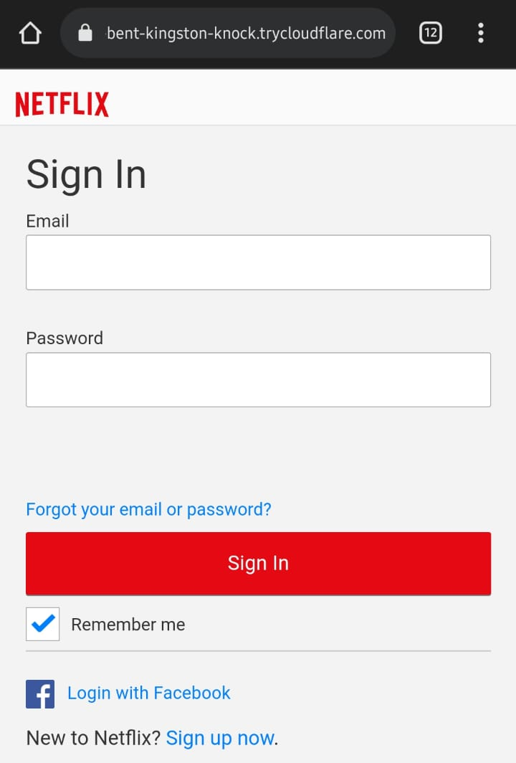
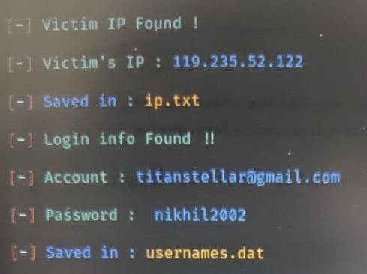
Phishing Attack
Netflix spoofed website
User Information

Slide 9
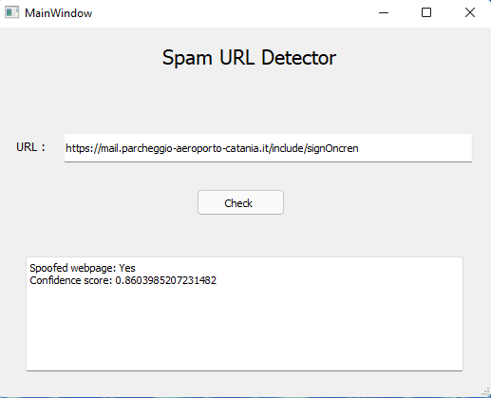
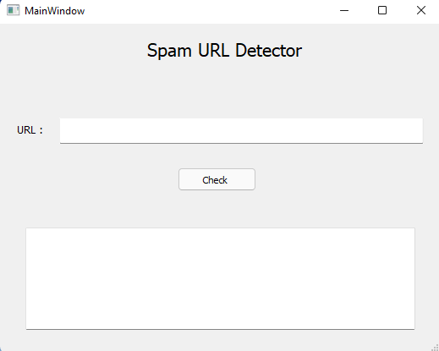
Detecting the Phishing page:

Slide 10
Future progress :
Working on this project is very knowledgeable and worth the effort.
Through this project, one can know a lot about the phishing websites and how they are differentiated from legitimate ones.
This project can be taken further by creating a browser extensions of developing a GUI.
These should classify the inputted URL to legitimate or phishing with the use of the saved model. Thank You….

Slide 11
Thank you☺
Nikhil Challa
Pranay Reddy Panta
Satwik Sangannagari
Sai Balaji Nandakuditi

